Slide 1
Visualization for Medical AI
Stephen Aylward, Ph.D.
Chair, MONAI Advisory Board
Senior Director of Strategic Initiatives, Kitware

Slide 2
How to avoid having to look at 261 CT slices, annotations, and MONAI segmentations in your jupyter notebook using matplotlib.
Stephen Aylward, Ph.D.
Chair, MONAI Advisory Board
Senior Director of Strategic Initiatives, Kitware

Slide 3
How to stay in the cloud.
Stephen Aylward, Ph.D.
Chair, MONAI Advisory Board
Senior Director of Strategic Initiatives, Kitware

Slide 4
Visualization for Medical AI
Stephen Aylward, Ph.D.
Chair, MONAI Advisory Board
Senior Director of Strategic Initiatives, Kitware

Slide 5
Outline
itkWidgets
Trame
VolView

Slide 6
Background
itkWidgets does not require ITK
Works with numpy arrays, MONAI metaTensors, pytorch tensors
Images, point sets, compare_images, …
VTK/vtk.js is at the heart of most viewers
itkWidgets, trame, VolView, OHIF / Cornerstone 3D, ParaView, 3D Slicer, …

Slide 7
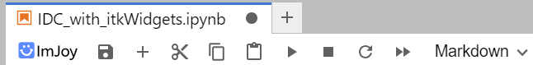
Getting started
pip install --pre itkwidgets[all]
pip install –pre itk
--pre : Must use pre-release!
[all] : supports jupyter lab, jupyter notebooks (not v3 yet), jupyter lite, Google Colab, Sagemaker Studio, Sagemaker Studio Lab, and Sagemaker Studio
Some systems must also pip install imjoy-elfinder
Some systems must re-load webpage
Look for imjoy icon (except on colab)

Slide 8
End-to-end AI visualization
Jupyter Notebooks: itkwidgets
3D visualizations
Never leave your notebook / the cloud
Custom Applications: trame and VolView
trame: write python to create a web application
VolView: a pure-javascript radiological application
no server required
V4.3: Python back-end available to host AI methods

Slide 9
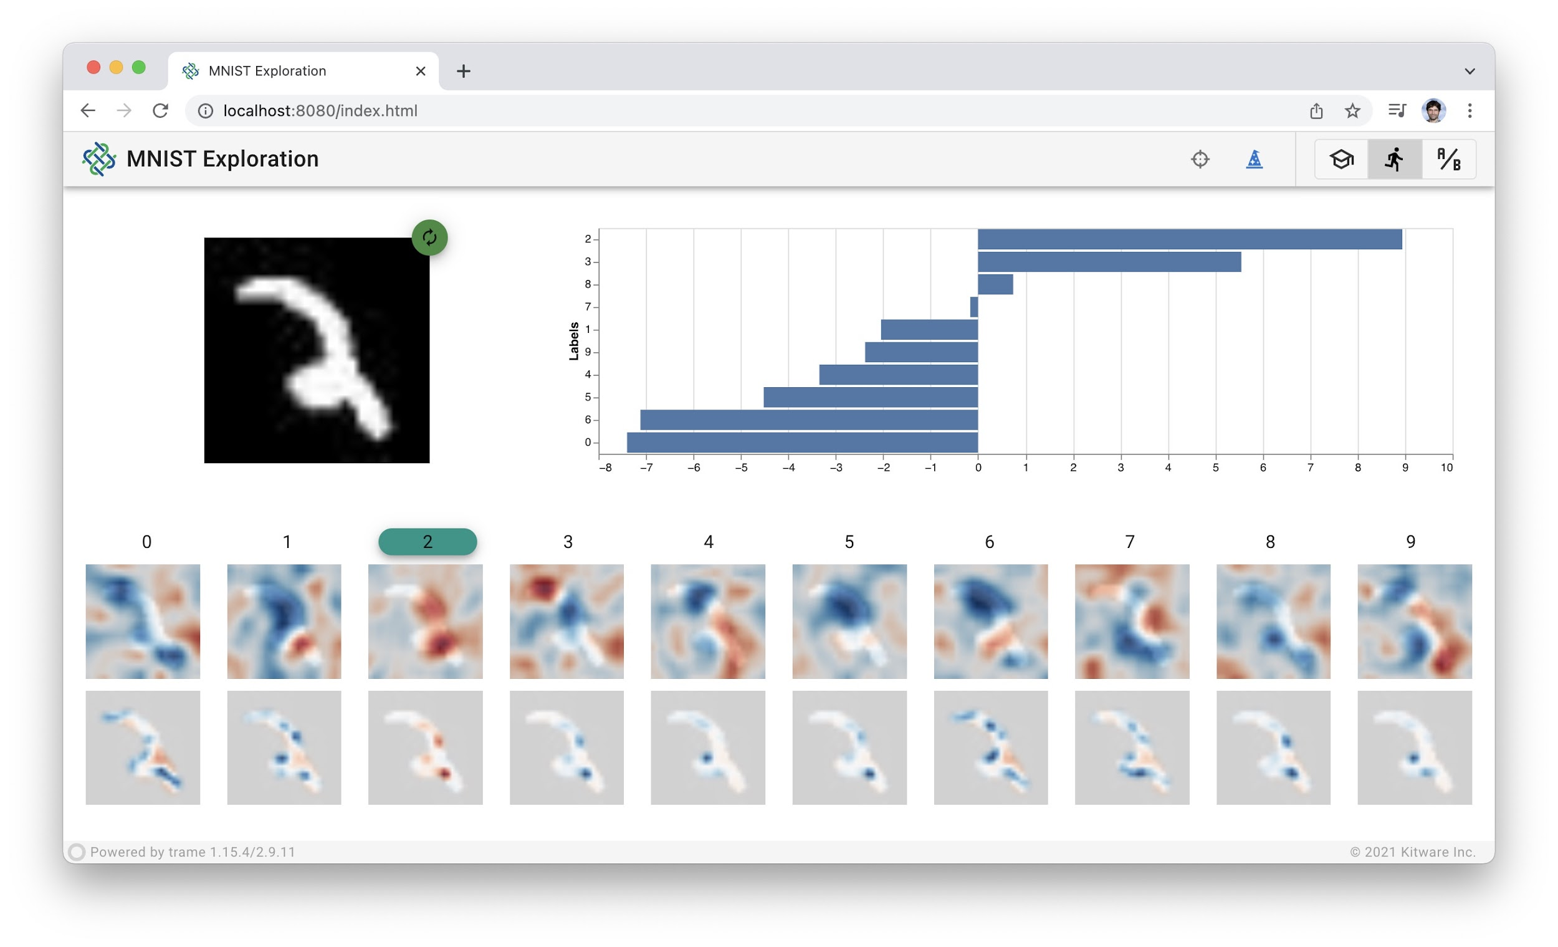
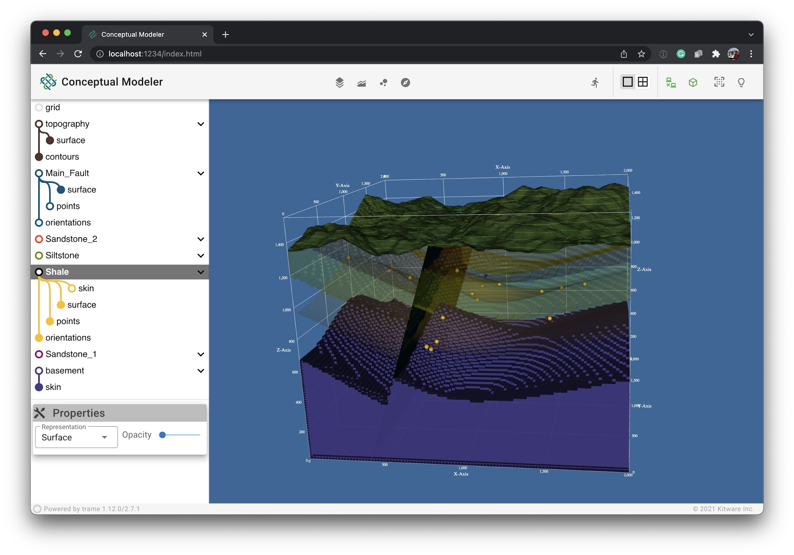
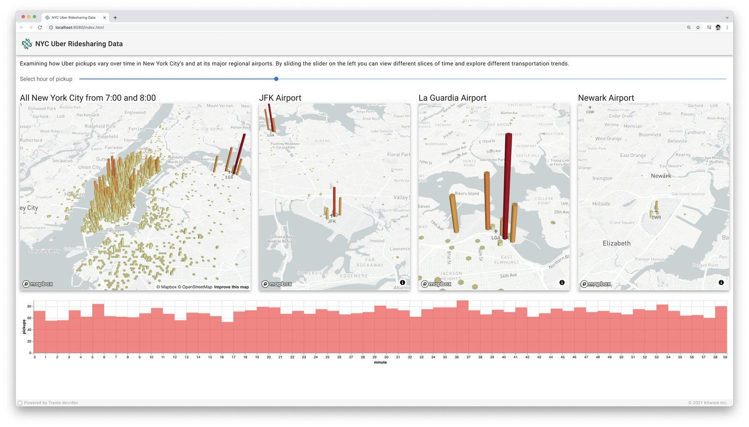
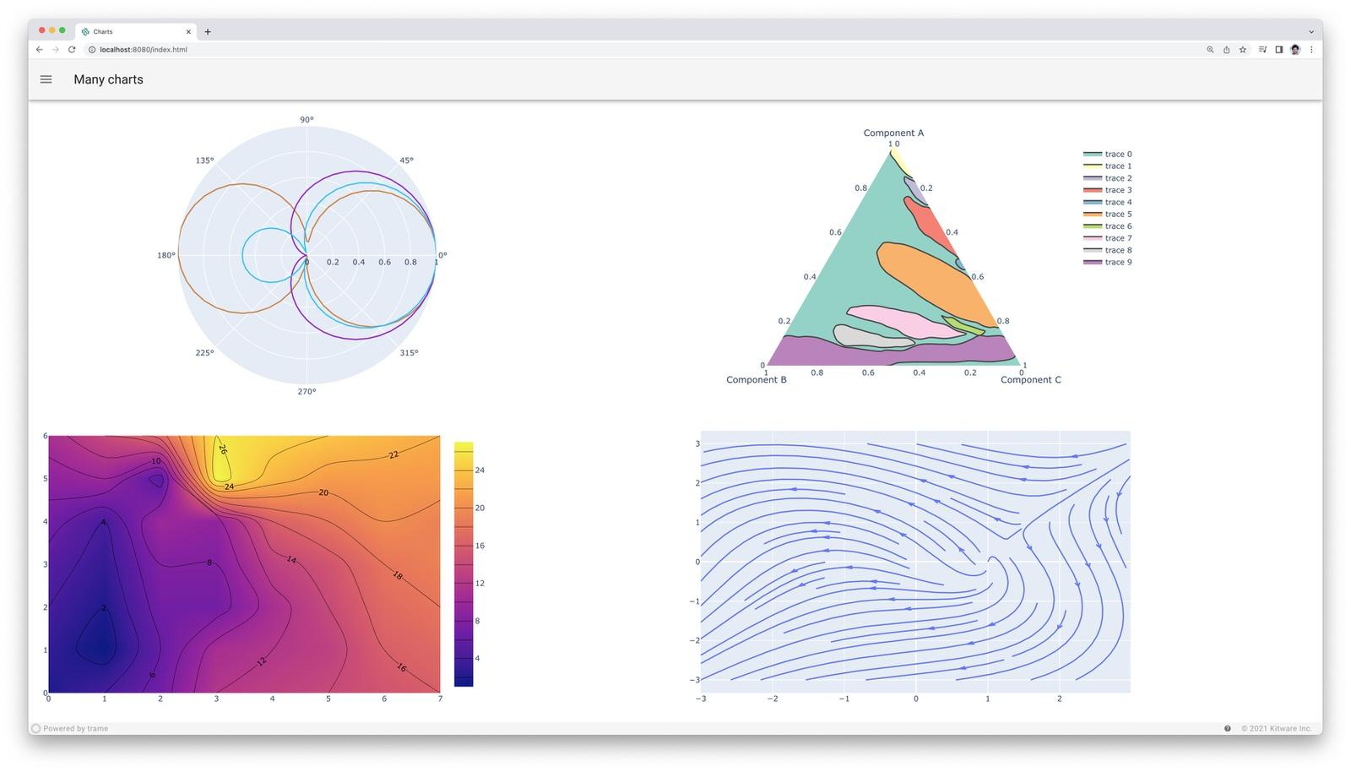
What is trame? (https://kitware.github.io/trame)
Python framework for interactive analytical applications (use numpy, Plotly, Matplotlib, VTK, …)
Runs locally or in the cloud, including via (AWS) notebooks
Displays everywhere: phone, tablet, laptop, workstation

Slide 10

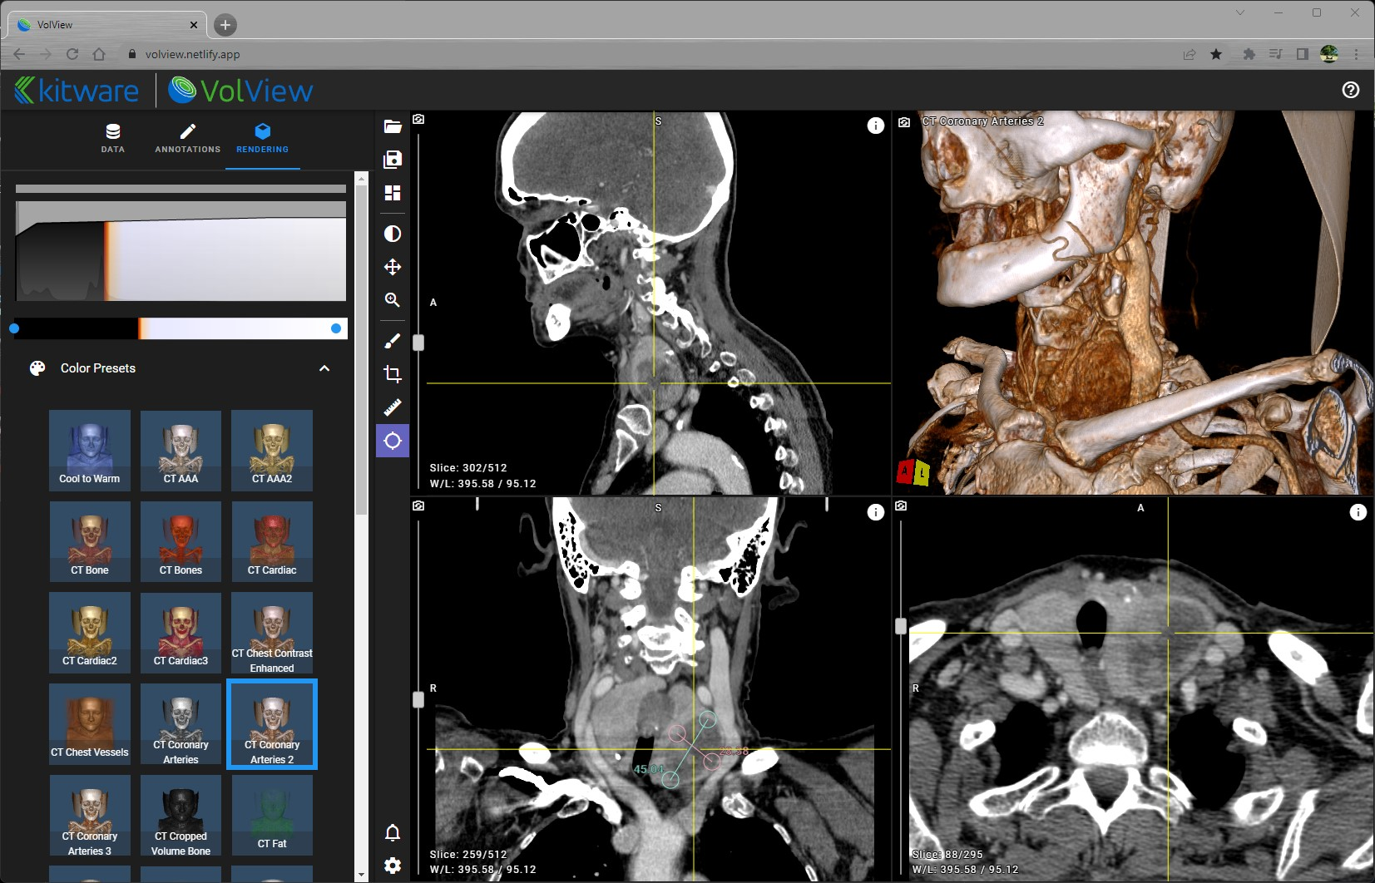
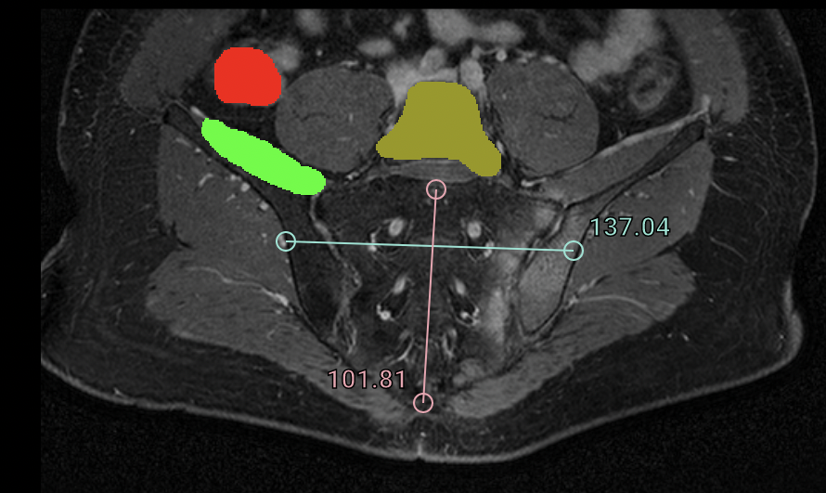
Run in “any” web browser
Drag-and-drop local data
Load via DICOMWeb, s3 buckets, …
No server required
Easily customized
3D foundation
Cinematic rendering
V4.3: Python server backend
https://volview-dev.kitware.app/?urls=[s3://idc-open-data/37760583-2b23-4665-b1bf-0e5da3be00cb/]

Slide 11
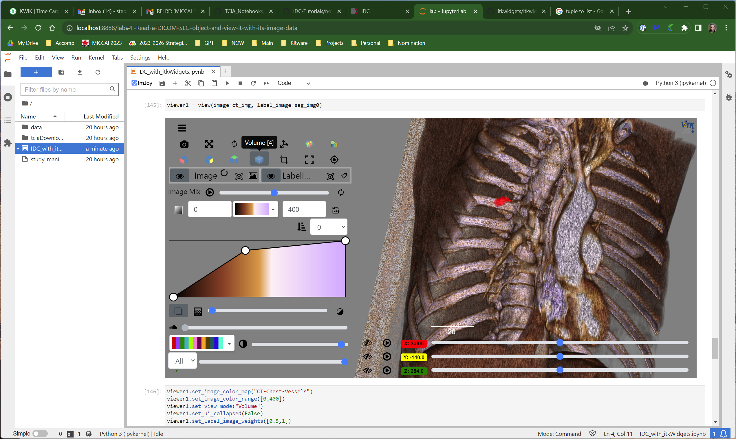
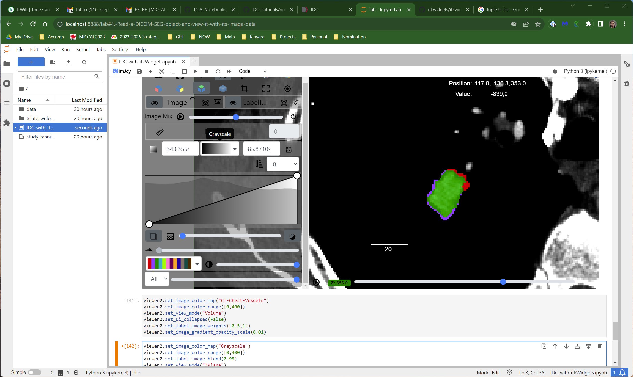
itkWidgets
https://github.com/aylward/itkwidgets-MICCAI2023

